Slide 1
StockSense - Deep Learning for Stock Market Dynamics
Michael Patrick

Slide 2
Introduction
In today's rapidly evolving financial landscape, gaining a comprehensive understanding of stock market dynamics is crucial for investors, traders, and financial analysts alike.
The complexities of stock markets are influenced by a multitude of factors, including historical price trends, market anomalies, and volatility patterns.
To address these challenges and provide actionable insights, This is a project that combines deep learning techniques to predict stock prices, detect anomalies, and forecast market volatility.

Slide 3
Introduction
This Model Works on Time Series data. This is a series of data points indexed in time order.
We’d discover and explore data from the stock market, particularly some stocks (Apple, Amazon, Google, and Microsoft).

Slide 4
Questions to be answered:
What was the change in price of the stock over time?
What was the daily return of the stock on average?
What was the moving average of the various stocks?
What was the correlation between different stocks’?
How much value do we put at risk by investing in a particular stock?
How can we attempt to predict future stock behavior? (Predicting the closing price stock price of APPLE inc using LSTM)

Slide 5
Scope
Data Collection, Methodology, Outcome

Slide 6
Data Collection
I’d be using the yfinance library which offers a threaded and Pythonic way to download market data from Yahoo Finance.com
Yahoo Finance is a rich resource center for financial market data.
Data cleaning and necessary transformations would be carried out using machine learning framework ‘scikit-learn’ and python library ‘pandas’

Slide 7
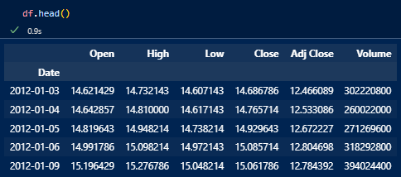
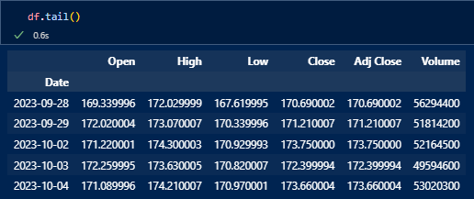
Predictive Features:

Slide 8
Methodology
Data Scaling, Model Selection, Model Evaluation

Slide 9
Methodology
Data Scaling:
Scaling technique used is MinMaxScaler() from sklearn.preprocessing
Chosen because of it’s Interpretability.
Min-Max scaling is intuitive and easy to understand. Rescaling all values to a range of 0 to 1 simplifies the interpretation of feature relevance.

Slide 10
Methodology [Model Selection]
1. LSTM Layers:
The selected model architecture is a Long Short-Term Memory (LSTM) neural network. LSTM networks are a type of recurrent neural network (RNN) designed to capture and learn patterns in sequential data.
The model consists of two LSTM layers with 128 and 64 units, respectively. LSTM layers are well-suited for time series data because they can capture long-range dependencies and remember information over extended sequences.
The choice of two layers adds complexity and enables the network to learn both short-term and long-term patterns in the stock price data.

Slide 11
Model Selection
2. Dense Layers:
After the LSTM layers, there are two fully connected (Dense) layers. The first Dense layer has 25 units, and the final output layer has 1 unit.
These Dense layers serve to interpret the features extracted by the LSTM layers and provide the final prediction.

Slide 12
Model Selection
3. Activation Functions:
ReLU (Rectified Linear Unit) activation functions are used throughout the model.
ReLU is chosen because it has been found to work well in a wide range of deep learning tasks.

Slide 13
Model Selection
4. Optimizer:
The Adam optimizer is employed for training. Adam is an adaptive optimizer that efficiently adjusts learning rates during training, making it suitable for time series prediction and forecasting tasks.

Slide 14
Model Selection
5. Batch Size:
During training, a batch size of 1 is used, this implies that the model updates its weights after processing each data point individually. This choice is common for time series data where each data point represents a distinct time step.

Slide 15
1. What was the change in price of the stock over time?
The closing price is the last price at which the stock is traded during the regular trading day.
A stock’s closing price is the standard benchmark used by investors to track its performance over time.

Slide 16
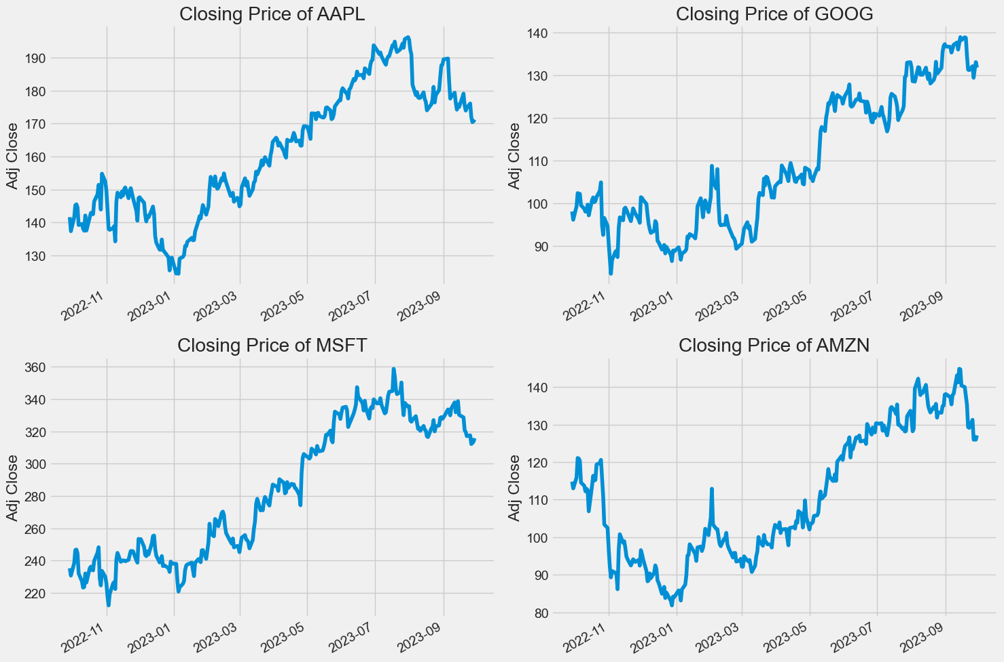

Slide 17
2. What was the daily return of the stock on average?
Now that we've done some baseline analysis, let's go ahead and dive a little deeper.
We're now going to analyze the risk of the stock. In order to do so we'll need to take a closer look at the daily changes of the stock, and not just its absolute value.

Slide 18
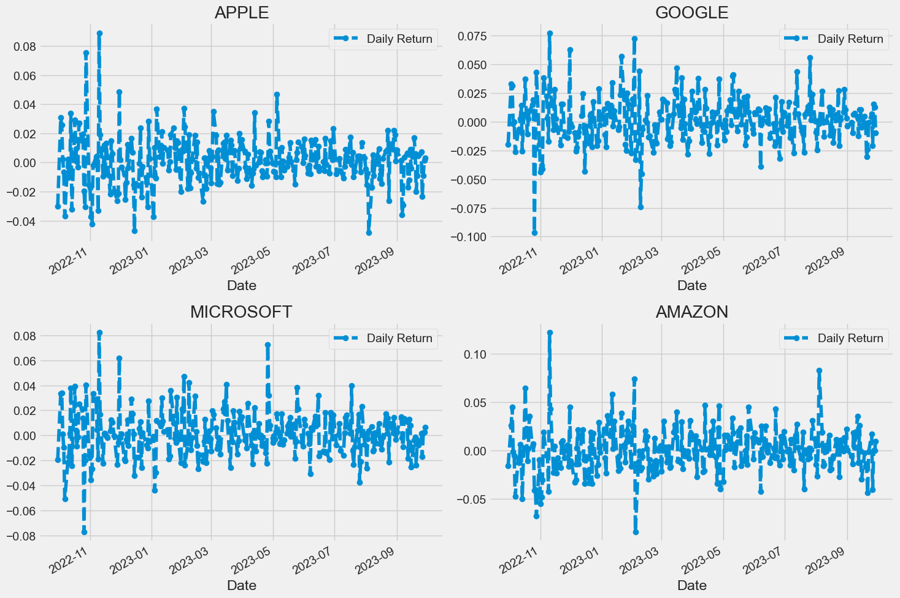

Slide 19
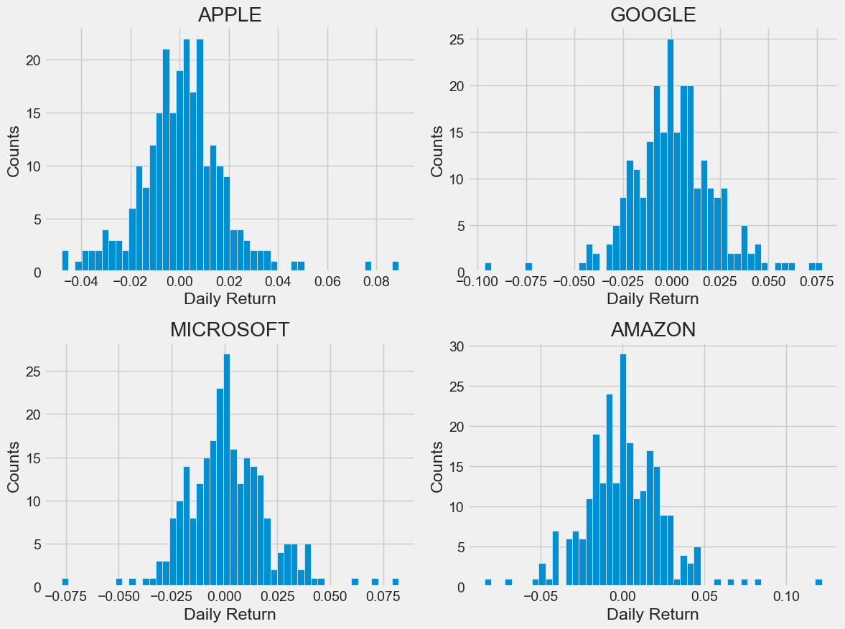

Slide 20
3. Correlation between prices of different stocks.
The closing price is the last price at which the stock is traded during the regular trading day.
A stock’s closing price is the standard benchmark used by investors to track its performance over time.

Slide 21
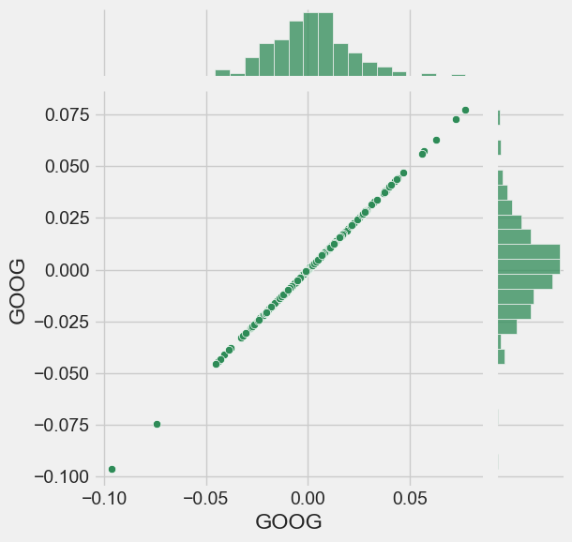
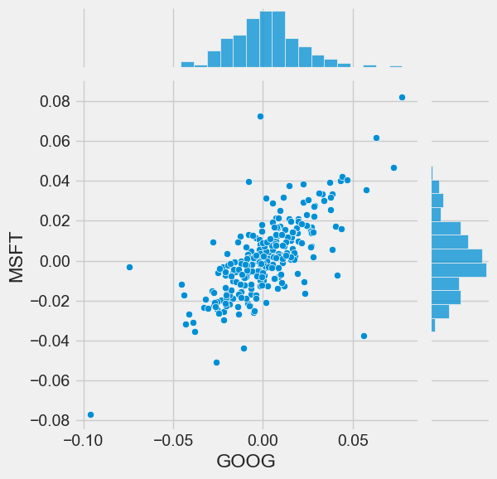

Slide 22
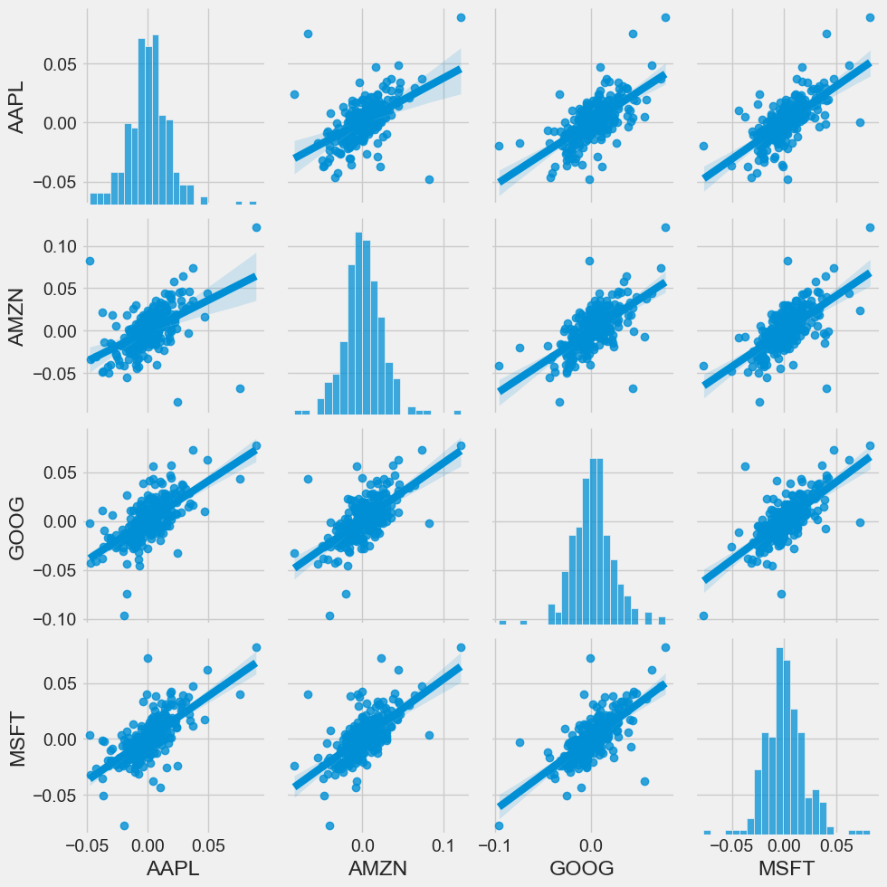

Slide 23
4. How much value do we put at risk by investing in a particular stock?
One of the most basic ways to quantify risk is to calculate the average daily return of a particular stock….
Then calculate the standard deviation of the expected movement from the actual movement.

Slide 24
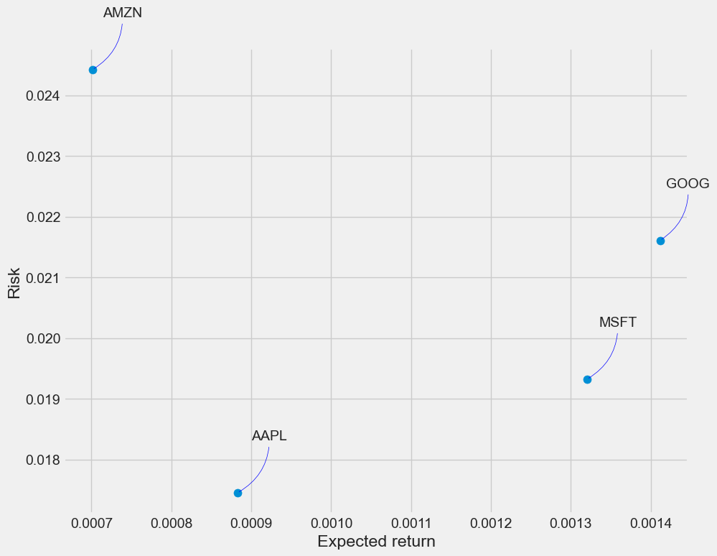

Slide 25
More on - Outcome
Calculating Root Mean Squared Error (RMSE):
The RMSE provides a quantitative measure of how well the model's predictions align with actual values.
It measures the average squared difference between predicted and actual prices. Often used to calculate the accuracy of the predictions.
Visualizing the model's predictions alongside actual data is crucial in assessing the model's performance and gaining insights into its behavior, therefore, a graph is plotted to display this.

Slide 26
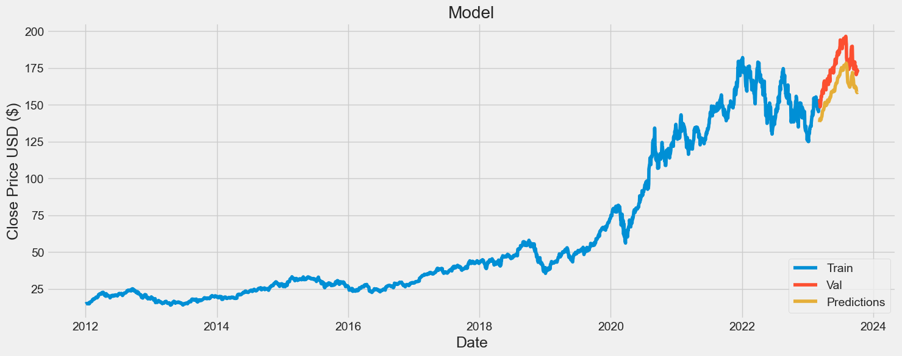

Slide 27
Workflow
Data Preprocessing
Stock Price Prediction
Anomaly Detection
Volatility Forecasting
Model Evaluation
1
2
3
4
5

Slide 28
Thank you
Michael Patrick
michaelpatrickjnr99@gmail.com
+233 24 890 3425
Prototype – Figma

